Slide 1



SUB-FUND MEETING
WELCOME!
Tuesday, October 3, 2023
11:00 AM – 1:00 PM

Slide 2
SUB-FUND
ADMINISTRATOR REPORT
Al Kirk
Conner Strong and Buckelew
BACCEIC Sub-fund Administrator
ERIC South Sub-fund Administrator

Slide 3
Welcome Members
Welcome New Member Bellmawr BOE!!

Slide 4
Welcome Members

Slide 5
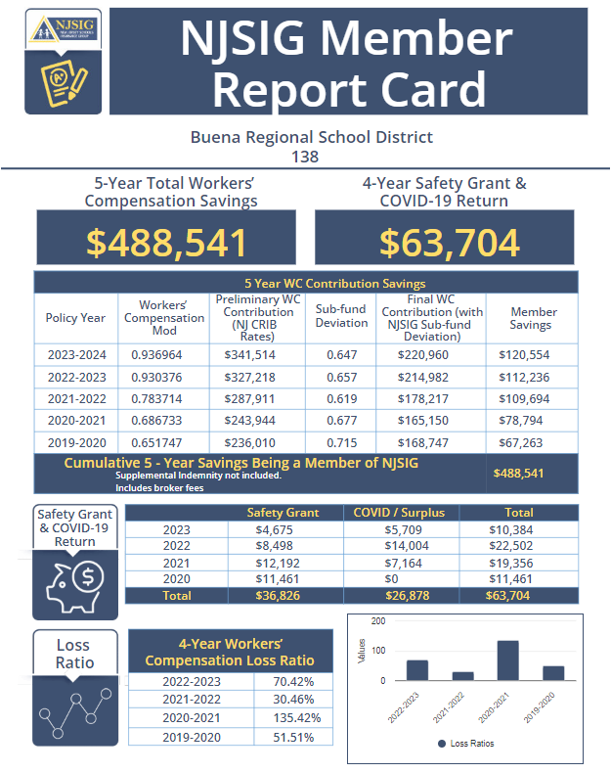

Slide 6
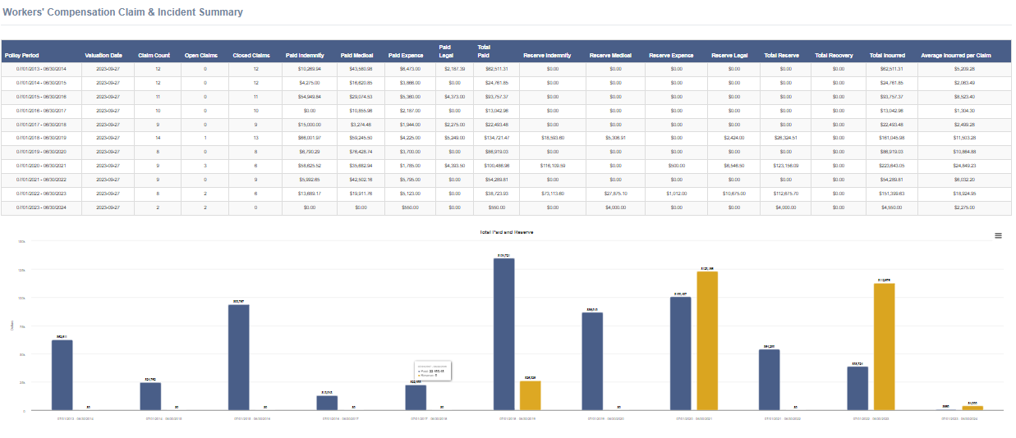
NJSIG’s Broker Dashboard

Slide 7
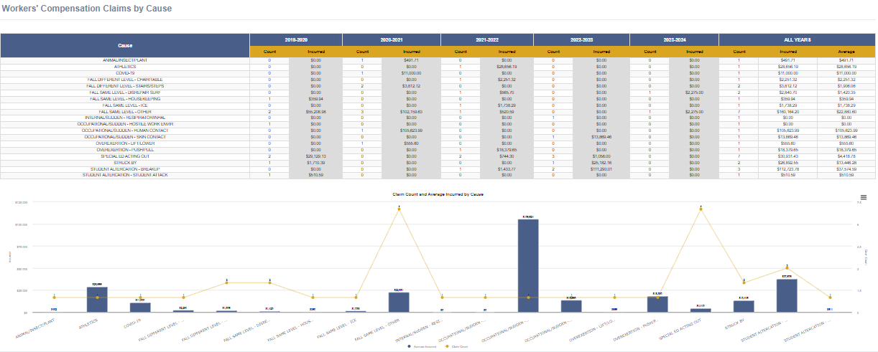
NJSIG’s Broker Dashboard

Slide 8


Slide 9
Support Staff – Live Training
October Schedule
Date | Class Topic | Time
10/4/2023 | Fire Safety | 11:00 - 12:00 pm
10/5/2023 | Chipper Safety | 10:00 - 11:00 am
10/5/2023 | Chainsaw Safety | 11:30 - 12:30 pm
10/6/2023 | Fire Extinguisher Safety | 10:00 - 11:00 am
10/6/2023 | Mower Safety | 1:00 - 2:00 pm
10/9/2023 | Schools: Safety Awareness Training for School Custodians/ Facilities Management | 8:30 - 11:30 am
10/9/2023 | Asbestos Awareness | 1:00 - 3:00 pm
10/11/2023 | CDL: Drivers' Safety Regulations | 10:00 - 12:00pm
10/11/2023 | Personal Protective Equipment | 1:00 - 3:00 pm
10/12/2023 | Hazard Communication/Globally Harmonized System (GHS) | 7:30 - 9:00 am
10/12/2023 | Bloodborne Pathogens | 9:30 - 10:30 am
10/12/2023 | Snow Plow/Snow Removal Safety | 1:00 - 3:00 pm
10/13/2023 | Leaf Collection Safety Awareness | 1:00 - 3:00 pm
10/16/2023 | Lock Out/Tag Out (Control of Hazardous Energy) | 10:00 - 12:00 pm
10/18/2023 | Driving Safety Awareness | 8:30 - 10:00 am
10/18/2023 | Bloodborne Pathogens Administrator Training | 9:00 - 11:00 am
10/19/2023 | Back Safety/Material Handling | 1:00 - 2:00 pm
10/23/2023 | Fire Safety | 8:30 - 9:30 am
10/23/2023 | Fire Extinguisher Safety | 10:00 - 11:00 am
10/23/2023 | Leaf Collection Safety Awareness | 1:00 - 3:00 pm
10/24/2023 | Chipper Safety | 8:30 - 9:30 am
10/24/2023 | Chainsaw Safety | 10:00 - 11:00 am
10/25/2023 | CDL: Drivers' Safety Regulations | 8:30 - 10:30 am
10/25/2023 | Asbestos Awareness | 11:00 - 1:00 pm
10/26/2023 | Personal Protective Equipment | 1:00 - 3:00 pm
10/30/2023 | Mower Safety | 11:00 - 12:00 pm
10/31/2023 | Snow Plow/Snow Removal Safety | 1:00 - 3:00 pm

Slide 10
Support Staff – Live Training
November Schedule
Date | Class Topic | Time
11/2/2023 | Playground Safety Inspections | 10:00 - 12:00 pm
11/2/2023 | Leaf Collection Safety Awareness | 1:00 - 3:00 pm
11/3/2023 | Lock Out/Tag Out (Control of Hazardous Energy) | 8:30 - 10:30 am
11/3/2023 | Personal Protective Equipment | 1:00 - 3:00 pm
11/6/2023 | Snow Plow/Snow Removal Safety | 9:30 - 11:30 am
11/6/2023 | Fire Extinguisher Safety | 1:00 - 2:00 pm
11/8/2023 | Chainsaw Safety | 8:30 - 9:30 am
11/8/2023 | Chipper Safety | 10:00 - 11:00 am
11/8/2023 | Bloodborne Pathogens | 1:00 - 2:00 pm
11/13/2023 | Shop and Tool Safety | 7:30 - 8:30 am
11/13/2023 | Fire Safety | 10:30 - 11:30 am
11/17/2023 | CDL: Drivers' Safety Regulations | 1:00 - 3:00 pm
11/20/2023 | Bloodborne Pathogens | 7:30 - 8:30 am
11/21/2023 | Leaf Collection Safety Awareness | 1:00 - 3:00 pm
11/28/2023 | Chainsaw Safety | 7:30 - 8:30 am
11/28/2023 | Driving Safety Awareness | 8:30 - 10:00 am
11/28/2023 | CDL: Drivers' Safety Regulations | 1:00 - 3:00 pm
11/29/2023 | Hazard Communication/Globally Harmonized System (GHS) | 8:30 - 10:00 am
11/29/2023 | Chipper Safety | 10:30 - 11:30 am
11/29/2023 | Shop and Tool Safety | 1:00 - 2:00 pm
11/30/2023 | Personal Protective Equipment | 8:30 - 10:30 am
11/30/2023 | Bloodborne Pathogens | 11:00 - 12:00 pm
11/30/2023 | Lock Out/Tag Out (Control of Hazardous Energy) | 1:00 - 3:00 pm

Slide 11
NJSIG UPDATES
Joe Semptimphelter
Senior Business Development Specialist
New Jersey Schools Insurance Group

Slide 12
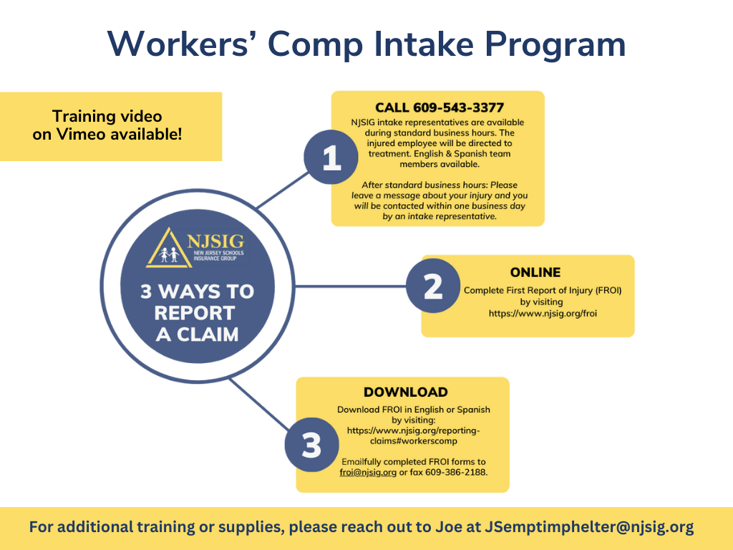

Slide 13
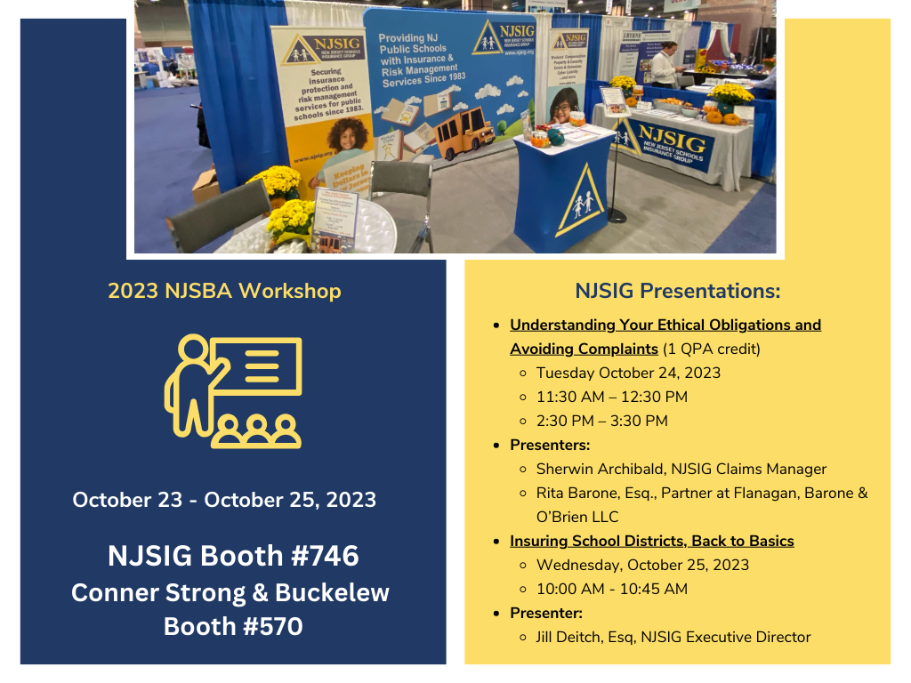

Slide 14
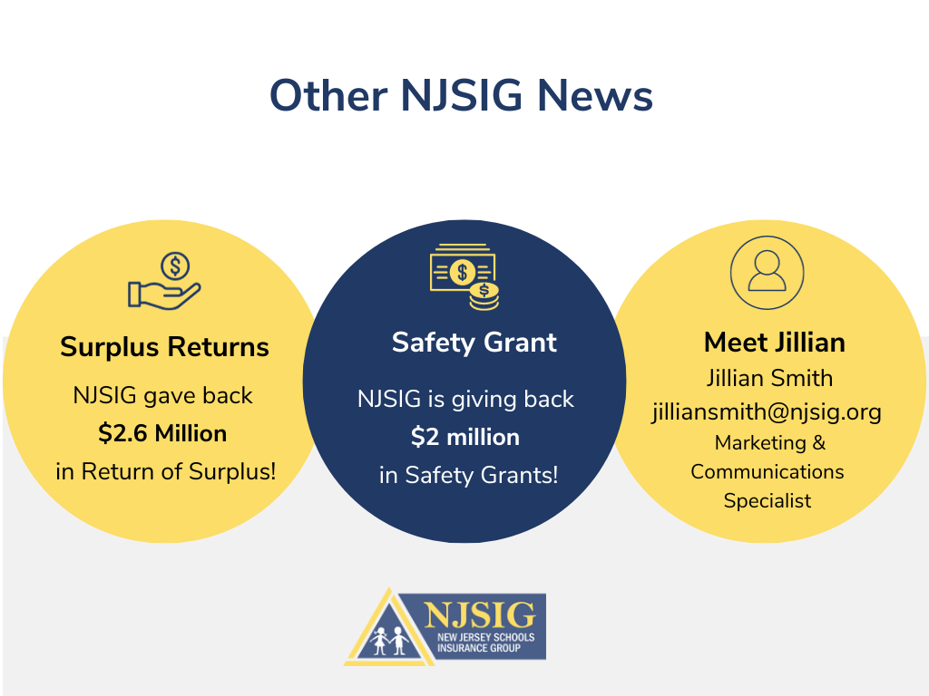

Slide 15

RISK MANAGEMENT 101
In this section we will review:
NJSIG’s Plan of Risk Management
The Importance of a Safety Committee
Accident Investigate
Modified Return to Work Policy
NEPHA Hotline – HR Legal Assistance
Cybersecurity Best Practices

Slide 16


PLAN OF RISK MANAGEMENT

Slide 17
NJSIG’s
Plan of Risk Management
NJSIG is a school board insurance group, also known as a joint insurance fund (“JIF”), formed under the provisions of N.J.S.A. 18A:18B-1, et. seq. NJSIG’s membership is comprised of public schools. NJSIG commenced operations in October 1983.
NJSIG’s objectives include the following:
Providing eligible public schools with a long-term alternative to the conventional insurance market as a means of stabilizing the otherwise cyclical nature of insurance expenditures;
Maintaining proactive safety and loss prevention programs specific to issues inherent in public schools;
Aggressively evaluating, defending and/or settling claims made against members which fall within the defined coverages afforded through NJSIG;
Maintaining a responsible funding posture in an effort to ensure long-term financial security for NJSIG and, by extension, the membership.

Slide 18
NJSIG’s Standards of Participation
The following are the eligibility requirements for new or continued membership as approved by the Board of Trustees:
Members’ claims history, policies and risk management philosophies should demonstrate safety performance and initiatives consistent with NJSIG’s requirements.
Members must provide access to all member-owned or leased property for safety inspection and evaluation by NJSIG’s Safety and Risk Control staff to ensure that all members meet or continue to meet safety standards.
Members are strongly encouraged to establish and maintain Safety Committees and actively participate in NJSIG-sponsored safety programs and trainings.
Any member with a loss ratio above 80% on any single line of coverage shall be evaluated by NJSIG’s Safety and Risk Control staff, who will assist the member in establishing an active Safety Committee and in maintaining recurring Safety Committee meetings. All such members shall also be required to participate in all safety programs and trainings offered by NJSIG.
Members must be in compliance with all Federal and New Jersey statutes governing the operations of public schools and the accompanying regulations.

Slide 19
NJSIG’s Standards of Participation
Members must promptly pay all contributions or other obligations arising out of or related to membership in NJSIG.
Members must actively participate in all NJSIG-directed meetings, programs and activities to ensure the continued successful operation of NJSIG.
Members must provide NJSIG with a properly executed resolution of participation, substantially in the form approved by NJSIG, and a properly executed indemnity and trust agreement, substantially in the form approved by NJSIG.
NJSIG will notify its members of any concerns as to the eligibility requirements outlined above. In each case, NJSIG will work with the members to address and correct any concerns. Continued participation with safety and loss control programs, as guided by NJSIG’s Safety and Risk Control team, will be required to remain eligible for membership in NJSIG. Should a member fail to work with NJSIG in addressing any eligibility concern, NJSIG may seek termination of membership as outlined in the NJSIG Bylaws.

Slide 20


Slide 21

Poll Students
Does your District have an active Safety Committee?
Yes
No
Notes:
Comment on responses

Slide 22
Benefits of Having a Health and Safety Committee
Establishing a health and safety committee in a school district can yield numerous benefits, all aimed at creating a safe and healthy environment for students, staff, and visitors. Here are several examples of these benefits:
Risk Mitigation and Accident Prevention: The committee can identify potential hazards within the school environment and develop strategies to mitigate risks, reducing the likelihood of accidents and injuries.
Compliance with Regulations: The committee can ensure that the school district complies with all relevant health and safety regulations and guidelines, avoiding penalties or legal issues.
Improved Awareness and Education: The committee can organize educational programs and training sessions to raise awareness about health and safety protocols, ensuring that all stakeholders are informed and educated.
Response Planning and Preparedness: The committee can develop emergency response plans, ensuring that the school district is prepared for various emergencies such as fires, natural disasters, or medical incidents.
Employee Engagement and Involvement: Involving staff in health and safety decision-making processes fosters a sense of ownership and responsibility, leading to better adherence to safety protocols.
Promoting a Culture of Safety: The committee can help instill a culture of safety where everyone values and prioritizes safety, leading to reduced accidents and improved well-being.

Slide 23
Benefits of Having a Health and Safety Committee
Reduced Absenteeism and Improved Productivity: A safe and healthy environment can result in fewer absences due to illness or injury and improved productivity among staff and students.
Financial Savings: By preventing accidents and injuries, the committee can save the school district money associated with medical expenses, insurance premiums, and legal fees.
Parent and Community Confidence: Demonstrating a commitment to health and safety through an active committee can enhance confidence and trust among parents and the community.
Continuous Improvement and Feedback: The committee can gather feedback from stakeholders, enabling continuous improvement in health and safety practices based on real-time experiences and suggestions.
Monitoring and Evaluation: The committee can conduct regular inspections and audits to monitor compliance with safety measures and evaluate the effectiveness of implemented health and safety initiatives.
Sustainable Health and Safety Practices: The committee can ensure that health and safety practices are sustainable and adaptable to evolving circumstances and emerging risks, ensuring the long-term well-being of everyone in the school district.
In summary, a health and safety committee in a school district plays a crucial role in creating a safe, healthy, and conducive learning environment, benefiting the entire school community in various ways.

Slide 24
Forming a Committee
Forming a safety committee in a school involves careful planning, communication, and collaboration. Here's a step-by-step guide to help you establish an effective safety committee within a school:
Assess the Need and Gain Support: Identify the need for a safety committee by assessing the existing safety measures, incident history, and potential risks within the school. Gain support from school leadership, including the principal and relevant administrators. Appoint a “STRONG” leader with authority it implement action.
Define Committee Objectives and Scope: Clearly outline the objectives, purpose, and scope of the safety committee. Determine the specific areas of focus, such as emergency response planning, hazard identification, safety training, etc.
Select Committee Members: Ensure representation from various stakeholders, including administrators, teachers, school nurses, security and support staff. Aim for a diverse group with expertise in different areas of safety and knowledge of the school environment. If you have multiple schools within your district, strive to have representation from each school.
Appoint a Committee Chairperson: Select a responsible and dedicated individual to act as the chairperson or coordinator of the safety committee. This person will lead meetings, facilitate discussions, and help ensure the committee's objectives are met. This is typically your School Business Administrator or School Safety Specialist.
Develop a Charter or Constitution: Create a formal charter or constitution that outlines the committee's purpose, membership, roles, responsibilities, meeting schedules, decision-making processes, and reporting mechanisms.
Conduct Orientation and Training: Orient committee members on their roles and responsibilities, the school's safety policies, relevant regulations, and any required training. Equip them with the knowledge and skills needed to effectively contribute to the committee's objectives.

Slide 25
Forming a Committee
Establish Meeting Schedules: Set regular meeting schedules for the safety committee. Ensure these meetings align with the school's academic calendar and are convenient for all members. Encourage punctuality and active participation.
Identify Key Safety Priorities: Collaboratively identify the main safety concerns within the school environment. Conduct safety audits, risk assessments, and seek input from stakeholders to prioritize areas for improvement.
Form Subcommittees or Workgroups: Establish subcommittees or workgroups to address specific safety focus areas, such as emergency response planning, safety drills, health and wellness, hazard identification, etc. Assign committee members to these subgroups based on their expertise and interests.
Develop Action Plans: Work with subcommittees to develop action plans to address identified safety concerns. Establish timelines, responsibilities, and measurable goals to track progress and ensure accountability.
Promote Communication and Transparency: Foster open communication and transparency within the committee and with the broader school community. Regularly update stakeholders on the committee's activities, progress, and outcomes.
Evaluate and Adjust: Periodically evaluate the committee's effectiveness, assess the impact of implemented safety measures, and gather feedback from stakeholders. Use this information to make necessary adjustments, refine strategies, and improve the committee's performance.
By following these steps, you can establish a functional and effective safety committee within a school, promoting a safer and more secure learning environment for everyone involved.

Slide 26
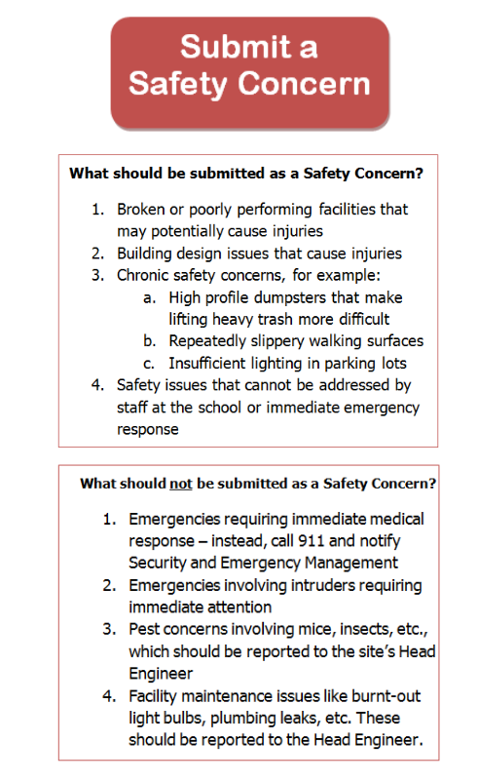
Encourage Open Communications

Slide 27
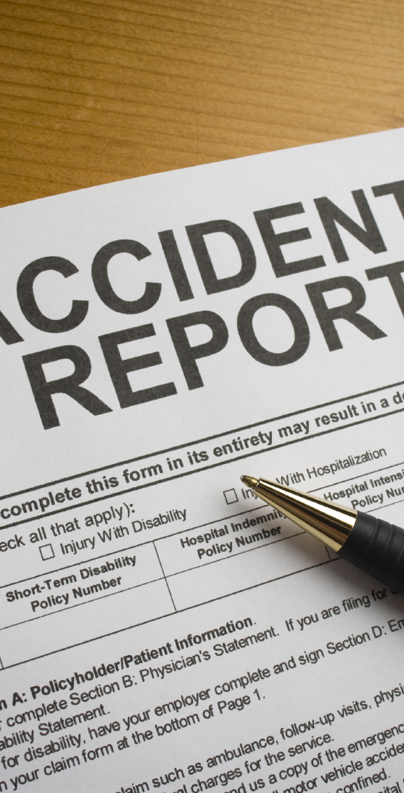
Accident Investigation
To Do: Before the Accident Occurs
Outline roles & responsibilities of individuals
Train key staff members
Establish communication flow protocols
Set up standard procedures
Know your post-accident drug / alcohol testing protocols
Notes:
Stress the need to investigate promptly. To do so, certain protocols need to be in place.
“In New Jersey, non-CDL drivers are over the legal limit if their blood alcohol concentration exceeds 0.08%. However, CDL holders are considered over the limit for licensing purposes if their blood alcohol content is higher than 0.04%.”
Post-Accident Testing: As soon as practicable following an accident involving a commercial motor vehicle engaged in commerce and operating on a public road, employers must screen each driver involved in such an accident for alcohol and controlled substances who (i) were involved in performing safety-sensitive functions if the accident involved the loss of human life; or (ii) received a citation under state or federal law within a certain period of time after the accident, provided the accident caused bodily injury to a person, resulting in immediate medical treatment, or one or more of the vehicles involved in the accident had to be towed from the scene. 49 C.F.R. 382.303
Reasonable-Suspicion Testing: An employer shall require a driver to submit to an alcohol and/or controlled substance test when the employer has reasonable suspicion to believe that the driver has violated the DOT Regulations’ prohibitions concerning alcohol and/or controlled substances. The employer's determination that reasonable suspicion exists to require the driver to undergo an alcohol and/or controlled-substances test must be based on specific, contemporaneous, articulable observations concerning the appearance, behavior, speech, or body odors of the driver, and may include with respect to controlled substances, indications of chronic use, or withdrawal. The required observations shall be made by a supervisor or company official who is trained in accordance with the DOT Regulations. 49 C.F.R. 382.307.

Slide 28
Poll Students
Does your district conduct a formal accident investigation when an incident occurs (i.e. injury to an employee, student or visitor)?
Yes
No
Notes:
Comment on responses

Slide 29
Train Employees in Event of an Injury
Employees at the scene should immediately
Call for medical assistance, if needed
Notify the Department
Secure and make the scene safe
Preserve equipment involved in incident
Train your employees on these actions.
Do not assume they know and will do them properly.
Notes:
Once we have an accident or incident to investigate, several activities will take place at the actual accident scene. If warranted by the circumstances, the scene may need to be barricaded and physically segregated against further injury or merely to preserve the scene for the initial investigation. (Ask the class for examples, such as a chemical spill).
Information to be recorded will be largely determined by the nature of the accident. (Examples are helpful here).
Preserve evidence – explain subrogation potential and the importance to holding on to damaged equipment When in doubt, call your claims coordinator claims administrator

Slide 30

Be Prepared to Respond to an Injury
Note paper & Accident Forms
Camera
Measuring tape
Barricade tape
Plastic bags
Clip board
Notes:
Gather equipment you will need to conduct a complete investigation. The first two are MUST HAVEs.
Suggest putting these items in a kit. When someone gets hurt, is not the time to run around your office trying to find all of these items or even remembering the list.

Slide 31
3 Basic Steps of an Investigation
Gather facts
Identify all contributing factors
Create plan to improve organization from lessons learned from investigation
Usually done by front line supervisors
Analyze facts of circumstances
Notes:
There are 3 basic steps for investigating an injury, or any accident.
Step 1 – someone must immediately start collecting the facts surrounding the event. Often managers are not immediately available so usually this step falls to the front-line supervisor. This is why it is so important to train many levels of supervisors in the accident review process.
Step 2 – With as much information as was collected in Step 1, someone must begin to assemble the facts into a timeline of decisions, actions, and circumstances that lead to the injury. Almost ALWAYS, this process will reveal multiple things came together to cause the event. These ‘things’ are called Contributing Factors, ie they all contributed to the cause of the injury. Identifying all the Contributing Factors gives the clearest picture of the event. It also leads AWAY from blaming the person involved. That person becomes one of many ‘things’.
Step 3 – What did the organization LEARN from analysis and how will those lessons be shared throughout the organization and the procedures, processes, training, tools / equipment, culture, etc. of the organization. If the organization learns and does not blame, the team grows stronger.

Slide 32
Poll Students
Are you the person responsible for gathering the facts around an injury;
such as what PPE was worn, where it happened, or talking with witnesses.
Yes
No
Notes:
Comment on responses

Slide 33
Poll Students Who Investigate Injuries
Do you routinely visit the site of the injury as part of your investigation.
Yes
No
Notes:
Discuss the importance of seeing for yourself the actual setting where the injury occurred.
LOWER ALL HANDS

Slide 34
Collecting Facts
At the Scene of the Injury
When the fact-finder arrives at scene:
Survey the scene for relevant information
Record key information
  Use forms as tools
  Take pictures – Key take-away of class
  Secure and save all video evidence
Secure / document equipment involved
Notes:
Typically this is a supervisor or a department head who will respond and begin the formal process of collecting information.
Start by getting a general overview of the location. Take pictures. You never know what might be important later on. For example, if someone tripped in a pothole. The size or exact location of the pothole may make a difference. It’s so easy to pull out a picture.
Record what you believe may be important. The JIFs provide some forms to help. We understand (Knock on wood) you do not investigate a lot of injuries. However, we do. Let us help you collect the best information. Remember NO FACTS = NO LEARNING or a favorite, GARBAGE IN – GARBAGE OUT.
Any equipment, such as PPE, tool or vehicle, should be protected and stored as part of the investigation. There could be product defect that contributed to the injury. If you can’t keep it, at least take a lot of pictures of it.

Slide 35

What are the advantages to visiting the scene and interviewing witnesses on site?
Advantages to interviewing witness at the site of the injury:
You & witness can walk-through the actions leading up to event
You & witness can see the scene together
Notes:
Here we see two men discussing a recent injury. Take a moment to look at it. I’ll have a question for you in a second.

Slide 36
Interviewing Witnesses in an Office
Advantages to interviewing witness in a private office:
Private and confidential
Calm
Comfortable
You can arrange the office to create the atmosphere you need
  Boss, caring manager, peers

Slide 37
Interviewing Witnesses
  Any one who saw, heard, or can add information should be interviewed
What has been your experiences when interviewing witnesses?
Are they completely open?
Are they eager or hesitant to tell you everything?
Has someone ever refused to cooperate?
Notes:
Who would you want to interview? Injured employee, witness, supervisors, etc.
Eye-witnesses can provide critical information about an accident as far as describing the activities and events that led up to the accident itself. The interview process should include the injured employee, if possible.
Determining past accident history with a particular operation, machine or work activity is valuable to evaluating future accident potential. However, this is not the only piece of information to be considered. A series of near misses in a particular area will not show up as past accidents, but may represent a potential for a serious future loss if left unchecked.

Slide 38
Key Take-Away
Separate the investigation process from the disciplinary process
Notes:
It is important to initially put the person being interviewed at ease by carefully explaining the purpose of the investigation itself. This process is fact-finding in nature and not a means to assess blame or discipline employees. Although there may be disciplinary action as the result of the accident, that process is distinctly different than the investigation process which seeks to obtain the root causes of an accident and propose solutions to identified problems.
A good technique is to ask open-ended questions, that is, questions that cannot be answered with just a one word response. This technique often provides the investigator with more information than questions that are not open-ended.
Stress importance of listening and summarizing what your understanding of the information provided.

Slide 39
Interviewing Tips
Interview witnesses separately
Put the person at ease
Establish facts and timeline
  No judgement or presumptions at this point
Ask open-ended questions
Let the person talk
Listen, ask clarifying questions, then summarize
Notes:
It is important to initially put the person being interviewed at ease by carefully explaining the purpose of the investigation itself. This process is fact-finding in nature and not a means to assess blame or discipline employees. Although there may be disciplinary action as the result of the accident, that process is distinctly different than the investigation process which seeks to obtain the root causes of an accident and propose solutions to identified problems.
A good technique is to ask open-ended questions, that is, questions that cannot be answered with just a one word response. This technique often provides the investigator with more information than questions that are not open-ended.
Stress importance of listening and summarizing what your understanding of the information provided.

Slide 40
Ask Open-ended Questions
Who – What – Where – When – Why
Who also was involved, present, nearby?
What happened?
  “Starting at lunchtime, walk me up to the accident.”
Where EXACTLY did it happen?
  Note relevant facts; weather, lighting, nearby features
When did it happen
  Relevant to shift, lunch, break time, or start of operation
Why did you do the job that way?
  What factors were considered in the decision?
Notes:
Be careful how you phrase the question. Remember, you must be careful not to imply judgement or pre-conclusions.
For example asking “WHAT HAPPENED?!” is very different than “starting when your crew got back to the worksite from lunch, walk me through the job up until the injury.”
Same with “WHY?” Make it clear you want to understand why things were done a certain way.

Slide 41
Review Pertinent Records
Review pertinent records
  Employee Manuals
  Job Hazard Assessments
Review history of past accidents
  At same or similar site(s)
  With same or similar equipment
  Doing same or similar activity
Notes:
Determining past accident history with a particular operation, machine or work activity is valuable to evaluating future accident potential. However, this is not the only piece of information to be considered.
A series of near misses in a particular area will not show up as past accidents, but may represent a potential for a serious future loss if left unchecked.

Slide 42

Analysis of the Facts

Slide 43
Root Cause Analysis
There will usually be several factors, or system failures, or causes involved in the injury
The district has several measures in place that may impact the outcome of an accident.
Hiring, training, & refresher training
Workflow and assignments
Equipment selection
Accident investigation is most effective when ALL the basic system(s) failure(s) are identified
Notes:
Root cause analysis has changed slightly in the safety industry. Root cause analysis now focusses on finding the most basic breakdowns and not the one single most important breakdown. Almost always, there were three or more things that contributed to the injury, Which ONE of the breakdowns was the most important is often arbitrary.
Contributing Factors are now referred to as ‘System Failures’ to highlight that it is not about one person, but how the organization created the person from hiring, through onboarding, through training and re-training, supervision, the agency’s policies and procedures, and so on. Whatever the person did, or did not do, is the product of who the agency created.
This can be a difficult concept. It says, you as the leader of the organization, had a large part of the injury, probably more than the individual. But continue on, YOU are the product of the organization. IT IS NEVER ABOUT A PERSON, but rather the systems of the organization.

Slide 44
Let’s See This in Action
The following report was given at a department-level review committee:
A cafeteria worker cut her hand while preparing lunches. She was not wearing her district-issued steel mesh cutting gloves.
She was counselled to be more careful and to wear her gloves from now on.
Notes:
Does this sound familiar?

Slide 45
1 - Ask “WHY” at least 5 times
Why wasn’t the worker wearing gloves?
The gloves are too big (i.e. would create a hazard to herself). Why are your gloves too big?
Only L and XL gloves are purchased. Why?
The Department has been purchasing the same gloves for years. Purchaser didn’t know more sizes were needed. Why didn’t they know?
Department (workers, union, others) never communicated need for smaller gloves. Why?
Notes:
It was easy (and fast) to blame the employee for not wearing gloves. However, you are on the committee and ask WHY wasn’t she wearing her gloves. The following is the exchange . . .

Slide 46
Systems Involved With This Worker
Hiring process
Training & re-training program
Purchasing process
Department PPE specification process
Supervision
Lines of communication between worker & supervisor
Lines of communication between supervisor & administration
Lines of communication between administration and purchasing
Notes:
Should hiring qualifications be changed for employees doing this job? Should more forceful persons be hired?

Slide 47
Which 1 System Most Failed This Worker?
In your CHAT box, enter which system you think contributed the MOST to this injury occurring?
Hiring process
Training & re-training program
Purchasing process
Department PPE specification process
Supervision
Lines of communication between worker & supervisor
Lines of communication between supervisor & manager
Lines of communication between manager and purchasing
Notes:
Most likely there will be multiple answers. This highlights the fallacy of a ROOT CAUSE Analysis. Trying to pick which ONE is subjective. And concentrating on the most basic or most important, or easiest to fix, or quickest answer is limiting if we are truly looking for learning and growth.

Slide 48
Class Poll
YES or NO
Do you think this was the first time the worker did not wear her gloves?
Yes
No
Notes:
I agree. This worker, and probably others, did not wear their gloves when doing this task before, maybe dozens of times, WITHOUT an injury and getting the job done.

Slide 49
2- Ask yourself, “WHY did the action or decision make sense at the time?”
Harder to blame the employee if the investigator understands the logic (even if flawed) of the decision / actions of the employee
Hindsight bias – worker under-estimated the danger of not wearing gloves – never got cut before
Moves investigation from the employee to the processes / systems that failed to prepare the employee
Notes:
Nobody expects their decision or action to result in a bad outcome. Certainly, the employee expected a successful outcome from his or her actions. It is important for the investigator to overcome their hindsight and confirmation biases by moving from their perspective, to that of the employee.

Slide 50
Supervisory System Breakdowns
Planning not sufficient for task
  Hazard(s) not identified or controlled
Instructions not sufficiently communicated
  Communication is a 2-way process
  Delivered by supervisors and received by employees
Procedure not sufficiently developed
Procedure in place, but not enforced
Training not sufficiently provided
Training not sufficiently reinforced
Notes:
The word ‘SUFFICIENTLY’ is used to indicate that even if he process was performed, the injury is evidence there there was a breakdown between the two parties involved; supervisor – employee, trainer – trainee, etc. It’s not the sole fault of either party. The system failure is in the process – not solely on either person.

Slide 51
Equipment System Breakdowns
Improper tools & equipment provided
Proper tools / equipment not readily available
Lack of preventative maintenance
Faulty design
Corrosion, wear, damaged
Not guarded
Improper inspection / documentation / reporting / follow-up

Slide 52
External Factors
Weather; temperature, precipitation
Condition of walking / working surface
Lighting and visibility
Noise Level
Housekeeping
External stresses – time demands (expressed or perceived)
Other; ventilation, vibration

Slide 53
Human System Breakdowns
Task exceeded employee’s knowledge, skills, or physical capacities
Unfit for duty
  Fatigue
  Emotional distress
  Prescription / illegal medications
Failure to apply training
Risk-taking behavior
  Drift & Normalization of Deviance
Notes:
Next slide discusses DRIFT & NORMALIZATION OF DEVIANCE

Slide 54
Safety Drift
Normalization of Deviance
Consider the following:
All workers have been not lowering the chute of the mower when cutting grass for months / years.
Supervisors have driven past jobsites for months / years.
Today, a rock from a mower is thrown and damages a nearby vehicle.
The gradual process by which the unacceptable becomes acceptable in the absence of adverse consequences
The shortcut slowly becomes the norm
What Systems Failed?
Notes:
normalization of deviance means that people within the organization become so much accustomed to a deviant behavior that they don’t consider it as deviant, despite the fact that they far exceed their own rules for the elementary safety.
In our example, often the employee would be blamed for not following a written procedure. And s/he didn’t. But what about the supervisors? What about the Department head who sets the tone for supervisors?

Slide 55
Slips / Lapses and Mistakes
Slips
  Not doing what you meant to do
    Pushing on the gas pedal rather than the brake
Lapses
  Forgetting to do something, or losing your place midway
    Getting interrupted and forgetting the wet floor sign up
Mistakes – decision-making failures
  Rule-based mistakes
    Policies, procedures, owners’ manuals
  Knowledge-based mistakes
Notes:
Most injuries fall into these categories – not from criminal acts or gross negligence
Slips and lapses
Slips and lapses occur in very familiar tasks which we can carry out without much conscious attention, eg driving a vehicle. These tasks are very vulnerable to slips and lapses when our attention is diverted even for a moment.
Slips: (‘Whoops’) ‘Not doing what you’re meant to do’.
Lapses: ‘Forgetting to do something, or losing your place midway through a task.’
Slips and lapses occur when:
■ the task is very familiar and requires little thought;
■ people confuse two similar tasks;
■ tasks are too complicated
■ the main part is done but the finer details are missed;
■ there are distractions and interruptions.
Mistakes: Mistakes are decision-making failures. The two main types of mistake are rule-based mistakes and knowledge-based mistakes. They arise when we do the wrong thing, believing it to be right.

Slide 56

Last Thought on the Analysis Phase
If your analysis concludes with any of these words:
Careless
Part of the job
One of those things
Accident prone
You need to dig deeper
Notes:
Our now-retired Safety Director used to refer to these conclusions as ‘Weasel Words’. it was just fate, we can stop looking. Nothing to see here. Nothing to learn. We’re good (perfect). Statistically, only about 2% of injuries / accidents can be truly considered unpreventable, such as a vehicle being stopped properly at a stop light and being rear-ended.
Think back to the investigations you’ve been involved in, how many were deemed unpreventable, ‘part-of-the-job’, ‘nothing could have been done differently’, etc. Probably more than 2 in a hundred.

Slide 57

Create an Action Plan
How will the organization share what was learned?

Slide 58
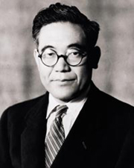
A New Mindset
“Every problem is really an opportunity.
Every system defect,
a treasure”.
Kiichiro Toyoda
Founder of Toyota
Notes:
The accident is in the past. We can’t change it. The only thing we can do is make sure we use the experience to better our organization. We must conclude our fact-finding, and analysis processes with a plan to improve our whole organization. We must move beyond blaming someone, or no one, and be committed to do the hard work of learning something and then addressing that deficiency.

Slide 59
Accountability
Backward-looking Accountability - Blame
  Tries to find a scapegoat, to blame (and shame) an individual for messing up
Forward-looking Accountability - Improvement
  Acknowledges the mistake and the harm resulting from it
  Lays out the opportunities (and responsibilities) for making changes to reduce the probability of such harm happening again
Notes:
Our new mindset extends to the concept of Accountability. Our traditional concept of Accountability is based in our rightly-respected judicial system. Based on making the ‘injured’ party ‘whole again’, from the money of the person / organization who harmed them. Good for the person, but harmful to society as a whole.
Once the lawyers are involved, everyone withholds information to protect themselves. Without information there is no learning.
Forward-looking Accountability acknowledges the mistake and the harm from the mistake. It does not rule-out reparations (monetary), but it does not require blame. It REQUIRES learning. It holds the organization accountable to learn from the event.
This is harder. It’s easy to point to the low-hanging fruit, blame them and pay off the injured party , and wash your hands of the whole thing. Everyone is ‘whole’ and justice served. But nothing changed. It is harder for the organization to look at itself, critique it’s shortcomings, and commit to fix them.

Slide 60
Create an Action Plan
Who will do what, by when?
Identify plan to address each cause / factor
  More than one control may be needed
  Reinforce good things
  Correct undesirable conditions / behaviors
Consider short term controls if permanent controls are not readily available
Consider the Hierarchy of Controls
Notes:
Identify controls to address root cause & each cause
More than one control may be needed
Reinforce good things
Correct undesirable conditions / behaviors
Consider short term controls if permanent controls are not readily available
Use the Hierarchy of Controls – next slide

Slide 61
Hierarchy of Controls
Eliminate the hazard
Isolate the hazard
Substitute a lower hazard
Engineering Controls
Administrative Controls
Improve policies and procedures
PPE
Improve PPE selection, policies, and procedures

Slide 62
Possible Action Plans
Morning instructions from supervisor were found insufficient
Provide supervisors with communication training
Reinforce to workers the desire of supervisors to ask questions if instructions are not complete or not fully understood
Workers were using a broken tool
Supervisors will inspect tools with crew at least 1/week
Mechanic will review & update inspection form
Worker tripped going down stairs carrying boxes
Smaller boxes will be ordered going forward
Notes:
Better Instructions or Job Planning
What condition or eventuality was not recognized or planned for? Why not?
What was missed when providing instruction for performing the job task?
Why was the instructions not understood by workers?
Repairs or Replacement of Equipment
How can damaged or worn equipment, tools, or supplies be identified & corrected?
Identify a better tool / piece of equipment for the job task
If the tool was available, why was it not used?
If a better tool is not available, consider buying it?
Better Way of Doing the Task
Develop a better way to do the job task; either in writing (SOP) or less formally
Training / Retraining
What actions need to be reinforced? How?
What actions need to be changed? How?
Better Decision-Making
What decisions made by the crew were flawed? Discuss the known information and missing information used by the worker to perform the job task in the manner it was.

Slide 63
Take Action & Monitor Results
Implement your plan
  Verify actions are being performed
Track Progress
  Interview employees
  Visit work sites
  Look for ‘Leading Indicators’
    What should you see if things are going as hoped
Monitor Results
  Track ‘Lagging Indicators’
    Accident rates

Slide 64
A Caution About Providing Training as an Action Plan
Often Action Plans cite need to re-train
Did the employee already know the proper procedure, policy, or process? Is there really a training shortfall?
Giving the same training in the same manner is not effective to change behavior
How will the new training be better
Better Plan:
Provide the new training to ALL employees
Notes:
Often the Safety Director / Risk Control Consultants see an injury review where the Action Plan is to ‘Retrain the employee’. Very often, the employee knew the process, procedure, or policy. Re-training on information already known, but disregarded once, is not an effective Action Plan. Providing the same information in the same manner didn’t work the first time, and most likely won’t work the next time.
Obviously, a new manner to provide the information must be developed. THAT is the Action Plan. How will the re-training be different? More emotional? More personal? More hands-on?
Also, if one worker made a mistake with the initial training provided, most likely all workers would benefit from the new training program. A better Action Plan would be to train ALL employees, not just the one who made the mistake. If nothing else, it would be a reminder.

Slide 65
What-if: We could not identify something that needs to be changed?
A small percentage of accidents are truly unforeseeable:
Thank employees for participating in the investigation
Tell them about all the things that were considered
Assure them you will continue to monitor situation
Notes:
Some injuries are truly unforeseeable. In order to let the employees know every injury is investigated thoroughly to find something to grow the organization, when this happens, don’t just do nothing. Instead consider these steps
Thank all the employees who provided information about the injury and the circumstances for their open and honest insights and facts. This lets the employees know why you interviewed them immediately afterwards _ and nobody was punished.
Tell the employees all the things that you considered as possible factors but eventually believe were proper. The more things you can specifically name, the more the impression is to the employees how hard you looked to make their job safer. A powerful message.
Close by committing to continuing to consider the circumstances of the injury and inviting them to do likewise.

Slide 66
The Challenge for Improved Accident Investigations
Creating a culture of trust & caring where accidents and near-misses are discussed, and where the team is held accountable to participate in the investigation process so the district can learn and grow.
Notes:
Have you ever heard the phrase, “I knew that was going to happen”. The question is why then didn’t the person who could changed something to prevent the injury know? Why didn’t the person feel respected enough to share their concern with leaders?

Slide 67


Questions – Comments?
Give a thumbs up if ready to continue
Wave if you have a question or comment

Slide 68

Return-to-Work (RTW) Program
A Return-to-Work program should minimize the productivity lost by the district and wages lost by the employee as a result of temporary partial incapacity resulting from on the job injury.
It is the express intent to provide modified duty within the employee’s restrictions whenever possible and to facilitate the employee’s full rehabilitation as rapidly as possible.

Slide 69
Return-to-Work Programs
A return-to-work policy outlines the procedures and guidelines for employees who are returning to work after a work-related injury. Below are examples of components that can be included in a comprehensive return to work policy:
Objective: Clearly state the purpose of the policy, emphasizing the organization's commitment to providing a safe and supportive environment for employees returning to work following a period of absence due to work-related injury.
Eligibility: Outline the criteria that determine an employee's eligibility to return to work, including compliance with medical clearance, readiness to resume duties, and any required documentation.
Communication and Notification: Describe the process for employees to notify their supervisor or HR of their intent to return to work, including the timeline for providing this notification and the relevant contact information.
Medical Clearance: Detail the requirement for employees to obtain medical clearance from their healthcare provider before returning to work. Specify the documentation or information needed to demonstrate their fitness for duty.
Return-to-Work Planning: Discuss the process for creating a return-to-work plan, involving collaboration between the NJSIG claims adjuster, employee, their healthcare provider, HR, and the supervisor. Highlight the importance of accommodating the employee's abilities and limitations.

Slide 70
Return-to-Work Programs
Duration of Accommodations: Clarify the duration for which temporary or modified duties will be provided and the review process to assess the employee's progress and potential adjustments to their duties.
Accommodation Process: Provide guidance on how accommodations will be determined, including assessments of the employee's abilities and consultation with healthcare professionals or other experts, if needed.
Wage and Benefit Continuation: Address the continuation of wages, benefits, and other entitlements during the period of modified duties or accommodations, ensuring compliance with legal requirements.
Employee Rights and Responsibilities: Outline the rights and responsibilities of the employee during the return-to-work process, including expectations for communication, attendance, adherence to accommodations, and compliance with medical recommendations.
Appeals and Grievances: Establish a procedure for addressing appeals or grievances related to the return-to-work process, ensuring a fair and transparent resolution mechanism.
It's essential to tailor the return-to-work policy to the specific needs and circumstances of the district, seeking legal and HR expertise to ensure compliance with applicable laws and regulations.

Slide 71
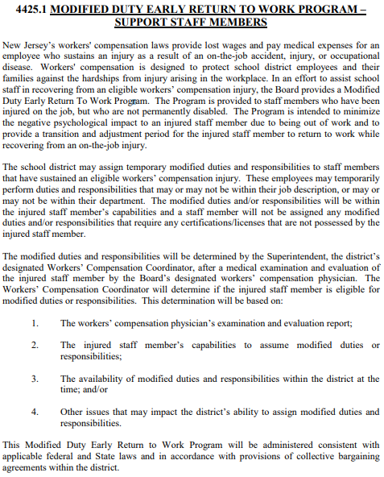
SAMPLE Return-to-Work Program

Slide 72
Why is it’s Important?
    Bring Back to Work!
    Title 18a
    70% Tax Free Wages
    Continuity
      Hiring Substitutes/Temps
        District: Paying two salaries
        Students: Consistency in the classroom

Slide 73
Examples of Modified Duties
Administrative Support:
    Assist with data entry, record-keeping, and other administrative tasks.
    Organize files, sort paperwork, and manage office supplies.
Light Cleaning and Tidying:
    Dusting, wiping surfaces, and light vacuuming in non-intensive areas.
    Tidying up common areas, such as break rooms or reception areas.
Assisting with Inventory and Ordering:
    Assist in tracking inventory levels and creating orders for cleaning supplies.
    Receive and organize incoming supplies, ensuring proper storage.
    Catalogue chemicals for Right-to-Know compliance.
Monitoring and Reporting:
  Conduct regular walkthroughs to monitor cleanliness and report any issues.
  Document and report maintenance needs, equipment malfunctions, or safety hazards.

Slide 74
Examples of Modified Duties
Light Maintenance and Repairs:
  Perform minor repairs, like changing light bulbs or fixing minor plumbing issues.
  Check and restock cleaning equipment, ensuring they are in working order.
Landscape and Outdoor Maintenance:
  Assist with light outdoor maintenance tasks like watering plants or sweeping walkways.
  Ensure outdoor areas are neat and free of litter.
Training and Learning Activities:
  Engage in safety training, customer service workshops, or other educational programs.
  Help create training materials or assist in organizing training sessions.
  It's crucial to tailor the light duty tasks based on the specific injury, capabilities, and medical advice provided for the custodial employee. Regular communication with the employee and their healthcare provider is essential to ensure they are not tasked with anything that could worsen their condition.

Slide 75
NJSIG’s Employment Practices Hotline Attorney (NEPHA)
Jodi S. Howlett, Esq.
Partner
Cleary Giacobbe Alfieri Jacobs, LLC

Slide 76
NJSIG Employment Practices Hotline Attorney (NEPHA)
201-623-1223 | NEPHA@cgajlaw.com
Deductible waived, if E&O claim is made and the hotline was used!
All districts that have school board leader liability or "SBLL" coverage, also referred to as Errors and Omissions or "E&O" coverage, with NJSIG are entitled to use NJSIG's Employment Practices Hotline Attorney (NEPHA) and its accompanying online employment resources, at no additional charge!
These valuable services can help your district avoid making employment decisions that can lead to costly lawsuits. When your district is considering taking an adverse employment action, please be sure to contact the hotline and get some valuable legal input first. An experienced local attorney that understands school law in New Jersey will thoroughly review the issues and promptly provide you with documented advice and a recommended course of action. This is all at no charge to the district. And then, if an E&O claim is made against the district but the district had consulted the hotline first, the district's E&O deductible will be waived for the claim!
(We ask that only superintendents, business administrators, and human resource managers make inquiries to the hotline.)

Slide 77
When to Call the Employment Practices Hotline
On a daily basis, school administrators face many difficult decisions in dealing with their employees. The NEPHA Hotline can help your district make the right decisions and avoid potential liability.
Here are 10 common situations that you may face where the hotline can help:
Requests for Family Medical Leave
Requests for Pregnancy Leave
Requests for Disability Accommodations
Coworker or Supervisor Harassment Allegations
Discrimination Complaints
Progressive Discipline (when to move to the next step)
Acquisition of Tenure
Reductions in Force
Employee transfers
Physical and Psychological Evaluations
The above is not intended to be a comprehensive list. When you have concerns regarding a difficult employee decision, CALL THE HOTLINE!

Slide 78

Cyber Risk Management

Slide 79
NJSIG’s Minimum Cyber Security Controls
NJSIG’s Cyber Security Controls criteria to receive a “Reduced Deductible” per the “Cyber Liability Fund Memorandum of Coverage”.
Cyber security controls criteria means:
Each of the Member’s software, services or devices accessed by the perpetrator at the time of the incident, event or related incidents or events giving rise to a Claim or Loss was protected by at least one layer of Multi-factor authentication at the time of the incident, event or related incidents or events giving rise to a Claim or Loss; and
Each of the Member’s devices that were accessed by the perpetrator at the time of the incident, event or related incidents or events giving rise to a Claim or Loss was protected by Endpoint protection at the time of the incident, event or related incidents or events giving rise to a Claim or Loss; and
Each of the Member’s employees that unintentionally committed an act that enabled the incident, event or related incidents or events giving rise to a Claim or Loss to occur had received Information technology security awareness and training within one year of the date on which the incident, event or related incidents or events giving rise to a Claim or Loss occurred; and
The Member maintained Weekly data backups that were Air-gapped from a network connection at the time of the incident, event or related incidents or events giving rise to a Claim or Loss, and the Member had successfully performed a test recovery from these data backups within six months preceding the incident, event or related incidents or events giving rise to a Claim or Loss.

Slide 80
Additional Cyber Security Measures
The following are additional cyber security measures you district should follow as outlined in the USDOE and CISA’s “K-12 Digital Infrastructure Brief: Defensible & Resilient” report:
Conduct an Asset Inventory
Mitigate Known Exploited Vulnerabilities
Manage Vendor and Third-Party Risk in Procurement Process
Enforce Minimum Password Strength
Develop and Exercise a Cyber Incident Response Plan
Join an Information Sharing and Analysis Center (ISAC)
  Multi-State Information Sharing and Analysis Center (MS-ISAC)
  New Jersey Cybersecurity & Communications Integration Cell (NJCCIC)
Run a Tabletop Exercise
.

Slide 81
Creating a Cyber Incident Response Plan
Effective cyber incident response planning requires coordination across a district. A solid response plan should outline:
Who is part of the cyber incident response team (e.g., administration, IT specialists, legal experts, media professionals and HR leaders)
What roles and responsibilities each member of the response team must uphold during an incident
What the district’s key functions are, and how these operations will continue throughout an incident
How critical workplace decisions will be made during an incident
When and how stakeholders and the public (if necessary) should be informed of an incident
Which federal, state and local regulations the district must follow when responding to an incident (e.g., reporting protocols)
When and how the company should seek assistance from additional parties to help recover from an incident (e.g., law enforcement and insurance professionals)
How an incident will be investigated, and what forensic activities will be leveraged to identify the cause and prevent future incidents

Slide 82

PRESENTATION
INSURING SCHOOL
DISTRICTS 101

Slide 83



VS.

Slide 84


Types of Insurance
Generally, the market for insurance for public schools can be divided into two broad segments:
  Property and Casualty:
    Workers’ Compensation
    Commercial General Liability
    Commercial Auto Liability
    School Board Leader Liability
    Property
    Cyber
      And more…
  Employee Benefits:
  Medical/Health
  Prescription
  Dental
  Vision

Slide 85

Employee Benefits vs. Property and Casualty
Hypothetical school budget = $125,000,000
  Employee Benefits = $12,000,000 (less than 10%)
  Property & Casualty = $1,000,000 (less than 1%)
    On average, your Workers’ Compensation insurance is approximately 50% of your P&C insurance costs

Slide 86
Commercial Insurance Distribution
Commercial insurance is typically placed with insurance companies using a licensed professional insurance broker.
Brokers offer varying degrees of expertise and can offer the ability to access insurers and provide risk management services.
Many individuals, business and organizations choose to use insurance brokers:
  The most recent report by the Insurance Information Institute shows that 76.8% of commercial insurance is placed using a broker (agency) while 22.4% of placements were direct with the insurer while 0.9% of placements were made using unspecified distribution channels.
  Reference: https://www.iii.org/fact-statistic/facts-statistics-distribution-channels
Most commercial insurers and joint insurance funds can not be accessed without utilizing an insurance broker.

Slide 87
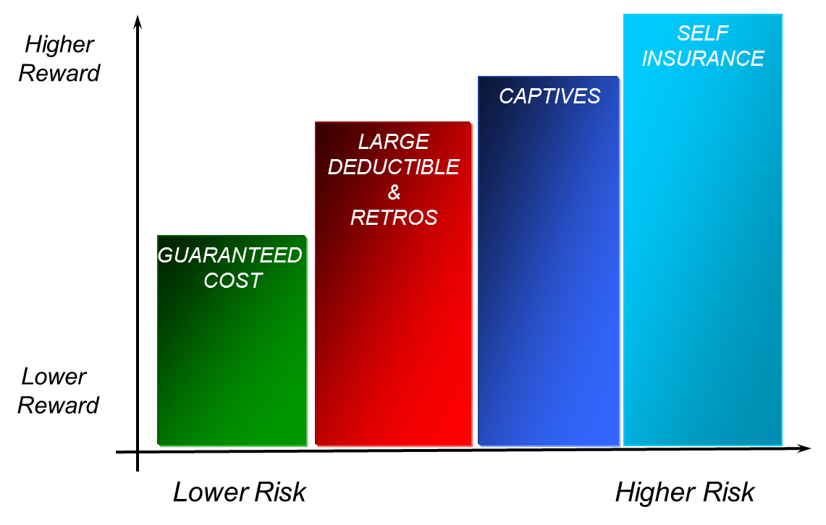
Types of Insurance/Risk Transfer Programs
The following are (5) different types of insurance/risk transfer programs. Starting at left is the lower risk, as you move to the right, the insured retains more risk.
Guaranteed Cost – Insured pays a fixed premium for policy regardless of losses
Large Deductible – Insured retains a portion of the loss through a sizeable deductible, ex: $100K
Retrospective Rating Program – Insured pays a premium up front, but the final premium is adjusted based on actual loss experience during policy term.
Captives – An insurance company created and wholly owned by one or more non-insurance companies to insure risk of owners:
  Heterogeneous – companies from various industries
  Homogeneous – companies from same industry
Self-Insurance – Risk management method used by larger companies with strong financials. A calculated amount of money is set aside to compensate for future losses.

Slide 88

Risk Pools (“JIFs”) vs.
Commercial Insurance Carriers
Association of Government Risk Pools (AGRIP) estimates that 80% of the nation’s 90,000 public entities are insured by one or more of the 500 government risk pools in the U.S.
Risk pools operate for the sole benefit of their members.
Risk pools are member-owned, member-governed and member-directed.
Risk pools do not operate for profit.
Unlike commercial insurance companies, whose goal is to collect enough premiums to make a profit for their shareholders, risk pools only want to collect the precise amount of member contributions to cover anticipated future losses.
A commercial insurance company will attempt to charge the most premium possible, to maximize profit for the shareholders.
A risk pool only wants to collect the right amount to cover future losses.

Slide 89
Risk Pools (“JIFs”) vs.
Commercial Insurance Carriers
(continued)
Risk pools were established and grew because commercial insurers abandoned public entities in the early 1980s.
Risk pools focus on the specific needs of a homogenous membership – so their coverages and policies can be specifically tailored to best suit that particular group (schools, municipalities, etc.)
Risk pools have no incentive to decline a claim. Any money collected in excess of what is needed to pay claims goes back to the members.
If a risk pool fails to collect enough money to cover its members’ losses, then the members must be reassessed, meaning the group would have to collect more money from its members, after the fact.
Most states (including New Jersey) require risk pools to have certified actuaries predict future losses for risk held in house.

Slide 90
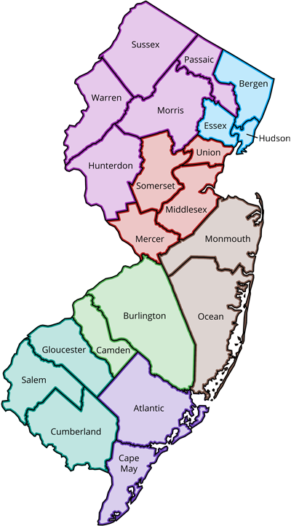
NJSIG Sub-funds
NJSIG’s membership is divided into (7) geographical Sub-funds as followed:
BACCEIC
(Burlington and Camden)
CAIP
(Atlantic and Cape May)
ERIC South
(Gloucester, Salem and Cumberland)
ERIC North
(Union, Somerset, Middlesex and Mercer)
ERIC West
(Sussex Passaic, Warren, Morris and Hunterdon)
MOCSSIF
(Monmouth and Ocean)
NJEIF
(Bergen, Essex and Hudson)

Slide 91
Overview of Insurance & Risk Management
Types of Hazards – Conditions that increases the frequency or severity of a loss.
Types of hazards are:
  Moral Hazard – Condition that increases the frequency or severity of loss from a person acting dishonestly – Deliberate act. (Example: underwriters are hesitant to insure vacant and unoccupied buildings because of the possibility that an insured will be tempted to intentionally start a fire to obtain an insurance recovery.)
  Morale Hazard - Condition that increases the frequency or severity of loss from careless or indifferent behavior – Unintentional but careless (Example: Careless driving)
  Physical Hazard - Condition of property, persons or operations that increases the frequency or severity of loss (Example: Icy sidewalk, defective wiring, inadequate ventilation/lighting)
  Legal Hazard - Condition of the legal environment that increases the frequency or severity of loss (Example: Some geographic areas are more likely to make large awards – Philadelphia known as “judicial hellhole”)

Slide 92
Overview of Insurance & Risk Management
Insurance: A contractual relationship that exists when one party (the insurer) for a consideration (the premium) agrees to reimburse another party (the insured) for loss to a specified subject (the risk) caused by designated contingencies (hazards or perils).
Law of Large Numbers – Idea of forecasting losses is based on this theory. The actual outcome becomes closer to the theoretical outcome, when a greater number of events are involved – meaning, you will forecast losses more accurately if you have 4,000 insureds, as opposed to if you have only 4 insureds.
Frequency vs. Severity – terms you hear in context of Risk Management and Insurance – Frequency - do you have a lot of losses? Severity - do you have high dollar amount losses?

Slide 93

Overview of Insurance & Risk Management
Insurance provides Indemnification. The purpose of insurance is to provide indemnification, which puts an insured in the same position they were in, prior to a loss happening. The point is “To make one whole again”, never resulting in a gain/profit.
Insurance
A Loss
No Loss
Profit
Principle of Indemnity: To Make Whole Again
Notes:
The purpose of insurance is to provide indemnification, which puts an insured in the same position they were in, prior to a loss happening. The point is “To make one whole again”, never resulting in a gain/profit.

Slide 94
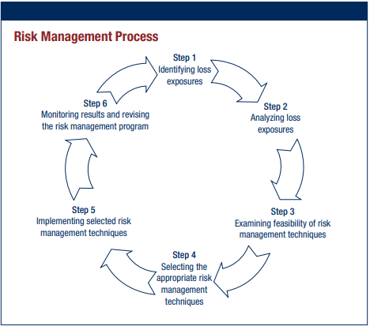
Overview of Insurance & Risk Management
Reference: American Institute for Chartered Property Casualty Underwriters

Slide 95

NJSIG Insurance Coverage Offerings

Slide 96

Insurance Coverage: Workers’ Comp
Workers’ Compensation (WC)
Supplemental Indemnity (SI)
Workers’ Compensation is a statutory coverage that operates to provide employees who are injured with predictable, prompt and equitable compensation for work-related injuries. In exchange for accepting these benefits, employees give up their right to pursue a tort action – also known as a personal injury lawsuit – against their employers. In NJ, the Employers’ Liability Insurance Law requires certain employers to show proof of their financial ability to meet the obligations created under the workers’ compensation statutory scheme. School District’s can do this in several ways:
By buying private insurance;
Self-insuring (having enough cash on hand to pay for WC claims themselves); or
By joining together with other boards of education to form a school board insurance group (“JIF”)

Slide 97
Insurance Coverage: Workers’ Comp
“WC” Coverage Form:
Workers’ Compensation Coverage Part 1: Statutory Limits
Employers’ Liability Coverage Part 2:
$3,000,000 each accident
$3,000,000 each employee
$3,000,000 policy limit bodily injury by disease
Other States Coverage Part 3: Applicable in all states except ND, WA, OH, WV and WY
“SI” Coverage Form:
Covers full salary of employees injured in the course and scope of employment, less wage loss due under Title 34, NJ Workers Compensation Act
Maximum benefit period: 52 weeks
Waiting period options: 0, 7, 30 and 60 days
Maximum weekly benefit: $2,500 available
Cost Containment:
Programs that support accident prevention, early return to work and discounted provider networks significantly reduce WC costs.

Slide 98



Insurance Coverage: Property
Property Insurance
Electronic Data Processing
Equipment breakdown
Site Pollution Incident Legal Liability
Property - What it does:
Pays the district for direct physical loss to real and personal property owned by the district and caused by a covered peril (i.e., fire, lightning, wind, hail).
Property - What it might do:
Cover mechanical and electrical failure of boilers, electrical panels, data processing equipment and transformers.
Protect from flood and earthquake.
Provide protection for the cost of compliance with the School Facilities Construction Act.
Property - Cost containment:
Reduce the probability of losses through regular inspections and preventative maintenance.
Adequately insure assets by accurately reporting exposures (i.e., addresses of buildings, square footage, building & contents values, whether the property is in a flood zone, etc.).

Slide 99
Insurance Coverage: Property
Commercial Property Limits:
$500,000,000 per NJSIG Pool Occurrence
Coverage Extensions:

Slide 100
Insurance Coverage: Property
Coverage Extensions (continued):

Slide 101
Insurance Coverage: Property
Commercial Property Deductibles:

Slide 102
Insurance Coverage: EDP
Electronic Data Processing Coverage (EDP) Form
Limits:
$500,000,000 per NJSIG Pool Occurrence
EDP coverage is automatically included in property coverage at no additional charge.
Deductible: $1,000 per occurrence
Extensions:
Data and media
Duplicate and backup “data” and “media” that are in separate storage locations
Computer Virus: $250,000 limit; $10,000,000 NJSIG pool aggregate
Newly acquired equipment
Transit
Loss of Income
Terrorism Sublimit included in property
Data Processing Equipment
Mysterious Disappearance excluded

Slide 103
Insurance Coverage: Equipment Breakdown
Equipment Breakdown Coverage Form
Limits:
$100,000,000 per Breakdown
Deductible: $25,000 per occurrence

Slide 104
Insurance Coverage: Site Pollution
Site Pollution Incident Legal Liability Coverage Form
Limits:
$1,000,000 Each Incident / $2,000,000 Aggregate (Per Member)
$11,000,000 NJSIG Annual Pool Aggregate
Deductible: $50,000 Each Incident; except for $250,000 for On-site Clean-up of Pre-Existing Conditions
Coverage:
“Phantom” tanks and above ground storage tanks covered
Illicit Abandonment - for waste materials illicitly/illegally disposed at covered locations by 3rd parties, i.e., so-called "Midnight Dumping" 3rd party claims for on-site and off-site bodily injury and property damage
On-site and off-site Remediation Expense subject to discovery and 3rd party claims triggers.
Non-Owned Disposal Sites covers 3rd party bodily injury and property damage claims, as well as clean-up costs, at non-owned locations where the insured sends their waste materials
Image Restoration - assists insureds with public relation needs following a pollution condition, subject to a $50,000 deductible and $250,000 aggregate sublimit.
9

Slide 105
Insurance Coverage: Site Pollution
Site Pollution Incident Legal Liability Coverage Form (continued)
Coverage:
Emergency Response Expenses – expenses incurred by an insured within 7 days of responding to the discovery of a pollution condition and reported within 14 days.
Transportation covers pollution conditions from 1st and 3rd party transportation of materials or wastes from the covered locations.
Covered Property: Any location owned, leased, rented, operated or occupied by the Insured at annual policy inception date. Coverage does not apply to new locations added after the current policy renewal.
No coverage for mold remediation expense.
No vacant land exclusion.
Pollutants definition has been amended to exclude all PFAS (perfluoroalkyl or polyfuoroalkyl substances).

Slide 106
Insurance Coverage: Crime
Crime Coverage Form
Limits:
Crime coverage extension limits as scheduled
Extensions:
Public Employee Dishonesty with Faithful Performance coverage, except statutory positions, if scheduled
Forgery or Alteration of checks, drafts, promissory notes coverage available, if scheduled
Loss of Money & Securities Inside and Outside Premises coverage available, if scheduled
Computer Fraud coverage available, if scheduled
Money Orders and Counterfeit Paper Currency coverage available, if scheduled

Slide 107


Insurance Coverage: GL | AL
Liability Insurance
General Liability (GL)
Automobile Liability (AL)
Liability - What It does
GL / AL pays the district for the cost of defending allegations of negligence and damages paid to third party plaintiffs who sustained bodily injury or property damage. These type of claims include slips, trips, falls, athletic injuries, libel, slander, invasion of privacy and occasionally the inexplicable acts of negligence on the part of others while on school property or under the district’s supervision. AL covers these type of claims when they involve the district’s operation of a motor vehicle.
Liability - Cost containment
Staff training, policies, signage and keeping the premises free of obvious and not-so-obvious hazards. Access to expert legal defense is of paramount importance. Defensive driving programs and strong Board policies regarding vehicle use are effective methods of reducing costs.

Slide 108
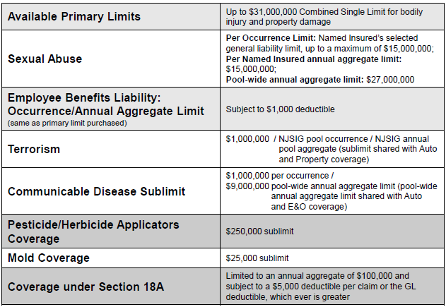
Insurance Coverage: GL
Commercial General Liability Coverage Form
Limits:

Slide 109
Insurance Coverage: GL
Commercial General Liability Coverage Form
Extensions:
Real and personal property in the care, custody and control of the Insured (includes Fire Legal Liability)
Worldwide Territory (as long as suit is brought within the United States)
Limited Additional Insured for managers / lessors of premises
Additional Insured: Employees, volunteers, PTAs, PTOs and home school associations all only while acting on behalf of and at the direction of the Board of Education, cosmetology students under school supervision. Foundations and affiliated 501c3 Corporations, as long as none of the following apply:
  Annual revenues exceed $100k or total assets exceed $500k;
  Have employees;
  Have corporate sponsorship;
  Affiliated with childcare; or
  Have liquor or host liquor liability exposures
Athletic participation (medical payments does not apply to athletic participants)
Corporal punishment
Internet liability
No medical payments

Slide 110
Insurance Coverage: GL
Commercial General Liability Coverage Form
Extensions:
No general aggregate
Contractual Liability Personal Injury / Advertising Injury Liability Expanded “Personal Injury” definition for law enforcement operations
Host Liquor Liability
Broad Form Property Damage
Incidental Medical Malpractice, including athletic trainers and school nurses
Unmanned Aircraft Systems / Drones Liability (total weight less than 10 pounds; owned or operated by the insured in compliance with current FAA regulations)
Watercraft Liability (owned, under 50’ in length; non-owned, no length limitation)
Extended Bodily Injury
Statutory compliance –Section 18A $100,000 limit
Notice / Knowledge of Occurrence Endorsement
NJSIG will offer a discount on General Liability with proof of Student Accident coverage
Unintentional Errors & Omissions Endorsement

Slide 111
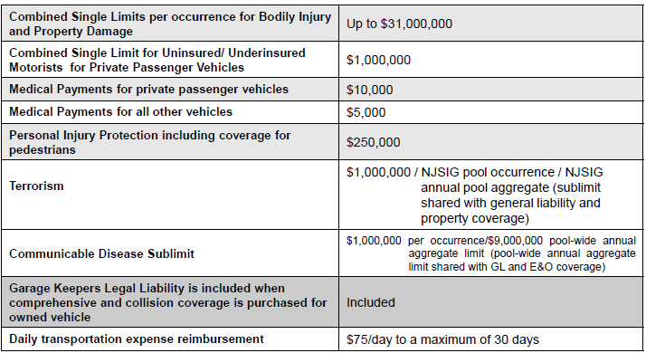
Insurance Coverage: AL
Commercial Automobile Liability Coverage Form
Covering owned, non-owned and hired vehicles.
Limits:

Slide 112
Insurance Coverage: AL
Hired Car Physical Damage Coverage Form:
Covers loss to a hired auto in any one loss subject to the lesser of:
$110,000 limit; or
The actual cash value of the damage or stolen property at the time of loss
The actual cost to repair or replace damaged or stolen property with other property of like kind and quality
Subject to the same deductible as owned autos
Only applies if you purchase Auto Physical Damage
$1,000 employee/volunteer deductible reimbursement coverage (deductible doesn’t apply)
Automobile Physical Damage Coverage Form:
Replacement cost valuation for buses less than 10 years old and 17 passenger or over is automatically included at no additional charge.

Slide 113

Insurance Coverage: SBLL
School Board Legal Liability (SBLL)
* also known as Errors & Omissions (E&O)
SBLL/E&O - What it does:
SBLL defends and indemnifies the district for allegations of negligent management. The most prevalent claims of this type are based on employment practices liability, such as harassment and discrimination.
SBLL/E&O - Cost containment:
Early settlements, which can be distasteful to the Board, can greatly reduces costs. Although some believe settlements invite other actions, large awards after costly litigation can garner significant attention. Expert, specialized legal defense can reduce indemnity costs. Staff training, a legal hotline and Board policies can reduce the frequency of claims.
New Jersey is a difficult legal venue for employment practices claims (NJ’s LAD is very plaintiff-friendly; fee shifting).

Slide 114
Insurance Coverage: SBLL
School Board Legal Liability Coverage Form
Pay on behalf, claims-made policy covering only those claims first made and reported during the policy period.
  Coverage A: Provides protection against “loss”, defined as monetary awards or judgments, sustained as damages, caused by a negligent act, error, omission, misstatement or misleading statement. Wrongful Employment Practices as defined including mental anguish and mental distress.
  Coverage B: Provides defense costs and prevailing party’s attorneys fees for specific administrative actions or suits.
  Limits:
  Coverage A: Up to $31,000,000 limits available
  Coverage B: $50,000 / $150,000 or $100,000 / $300,000 or excluded
  Communicable Disease Sublimit: $1,000,000 per occurrence/$9,000,000 pool-wide annual aggregate limit (pool-wide annual aggregate limit shared with GL and Auto coverage)
Deductible:
Minimum deductible of $5,000 for districts with an ADA under 2,000 students.

Slide 115
Insurance Coverage: SBLL
School Board Legal Liability Coverage Form
Definition of “Claim”:
Does not include: Collective Bargaining Agreements; Public Employment Relations Commission Complaints; School Ethics Commission Complaints
  Extensions:
Prior Acts to 7-1-86, available subject to qualifications Defense costs, in addition to the annual aggregate limit of liability under Coverage A policy form Coverage for legal actions arising out of hiring, firing, promotion or demotion
Coverage for alleged violation of federal or state civil rights
Discrimination Coverage for employees and students
Employment Practice Liability, Due Process Petition (IEP disputes) Defense Coverage
Automatic 60-day reporting period; Optional one or two-year extended reporting period
Front and back wages included
Reasonable consent on claims added for most accounts

Slide 116

Insurance Coverage: Cyber
Cyber Liability
Cyber - What It does
Cyber insurance provides coverage in the event of a cyberattack or data breach (i.e., an attempt to steal, expose, alter, disable or destroy information through unauthorized access to a computer system).
Cyber policies cannot prevent cyberattacks -- for that, schools need proper cyber security controls. But cyber policies can help in the event of an attack.
Cyber policies often provide a professional response team that will immediately respond in the event of a cyberattack or breach.
Cyber policies can also cover various expenses associated with data breaches, including investigation costs, legal fees, public relations costs, notification costs, credit monitoring, fines and penalties, and loss resulting from identity theft.
Cyber policies may also cover property losses due to business interruption, data loss/destruction, equipment destruction, computer fraud, funds transfer loss, and cyber extortion (ransom).

Slide 117
Insurance Coverage: Cyber
Cyber Liability Coverage Form
Limits:
Coverage provided for:
Data & Network Liability
Regulatory Defense & Penalties
Payment Card Liabilities & Costs
Media Liability
Breach Responses Costs, including Legal Advice, IT Forensics, Notification Cost (including Call Center), Credit Monitoring, Public Relations

Slide 118
Insurance Coverage: Cyber
Cyber Liability Coverage Form
Deductibles:
The individual Beazley Insurance Company member retention remains at $500,000 per claim made. However, NJSIG will reimburse members for a portion of their Beazley retention based on the following schedule:.
Member total revenues that are less than $100,000,000:
  Per claim standard deductible: $250,000.
  Per claim deductible only if the member satisfies the Minimum Cyber Security Controls criteria as defined in the “NJSIG Cyber Liability Fund Memorandum of Coverage” approved by the NJSIG Board of Trustees: $25,000.
Member total revenues that are greater than or equal to $100,000,000:
  Per claim standard deductible: $250,000.
  Per claim deductible only if the member satisfies the Minimum Cyber Security Controls criteria as defined in the “NJSIG Cyber Liability Fund Memorandum of Coverage” approved by the NJSIG Board of Trustees: $50,000.
Whether a member met the Minimum Cyber Security Controls criteria at the time of the event will be determined by NJSIG, in conjunction with the cyber forensic investigator retained by Beazley Insurance Company, during the investigation into the cyber incident.

Slide 119
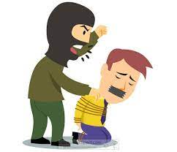
Insurance Coverage: Crisis Management
Crisis Management
Insured Persons:
School board members, administrators, employees, students anywhere. Parents, family members, volunteers, alumni and guests while on insured’s premises and attending or participating in an event or activity sponsored by the school district.
Expenses Includes:
Increased costs of security due to hostage crisis or hijacking including but not limited to hiring of security guards, hiring of armored vehicles and overtime pay to exiting security staff for a period of up to 90 days, provided that security consultant of carrier has recommended such security measures.
Fees and expenses of carrier approved public relations consultant.
Fees and expenses of independent forensic analysts engaged by the insured.
Medical services and hospitalization costs incurred by an insured person and paid as a result of a kidnapping, extortion, wrongful detention, hostage crisis or hijacking.
Other costs incurred with the carrier’s prior written consent.

Slide 120
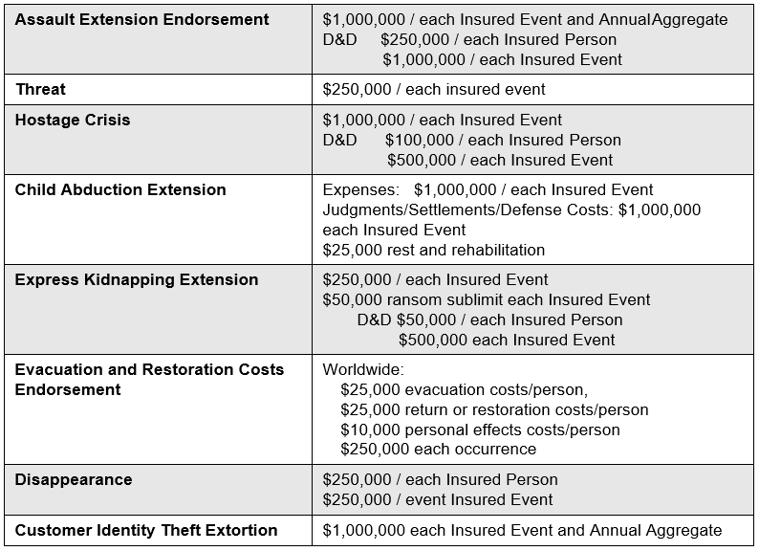
Insurance Coverage: Crisis Management
Crisis Management Coverage Form
Limits:

Slide 121

Insurance Coverage: Restart
RESTART
An innovative program to help members with access to capital to finance part of the reconstruction after an Active Assailant tragic event.
Program has limited coverage and specific terms.
Designed to assist members while avoiding possible moral hazard
Limit: $5,000,000 per occurrence and $10,000,000 program aggregate.
Co-insurance retention 25% for demolition and 75% for reconstruction.
Active Assailant Incident:
A premediated malicious physical attack by an Active Assailant … who is present with a “Weapon” who … causes direct physical loss, damage or destruction to Insured Property within a Covered Location or serious bodily injury or death to three (3) or more persons physically present during such attack.

Slide 122
Questions – Comments?
Give a thumbs up if ready to continue
Wave if you have a question or comment

Slide 123


Thank You!

